Slide 1
INTRODUCTION TO COMPUTER

Slide 2
Overview
Computer Essentials
History
Components of the Computer
Types of computers
Information and Communication Technology
Hardware
Software
System and Application Software
Software license

Slide 3
Computer Essentials
This module sets out essential concepts and skills relating to the use of devices, file creation and management, networks and data security.

Slide 4
HISTORY BRIEF:
Charle’s Babbage (British Mathematician and Mech. Eng); invented the concept of computer in 1822.
Konard Zuse (German base scientist ): first to build a programmable computer, 1935-1938 in Berlin. Then in 1941 developed Z1 machines, which was destroyed by the II world war.
Tommy Flower (British telephone Eng.): build electronic computer used to encrypte messages between German command during the II world war.
Dr. John Von Neumann (incredible Hungarian-American base Mathematician, Physician, computer Scientist and Polymath or universalist): Design Von-Neumann architecture in 1945.

Slide 5
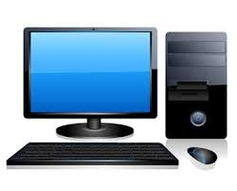
Computer: is an electronic device that accepts input data, process the data into information meaningful to the user. Components of a Computer: System unit Keyboard Monitor Mouse
Monitor
System unit
keyboard
Mouse

Slide 6
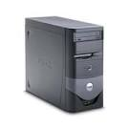
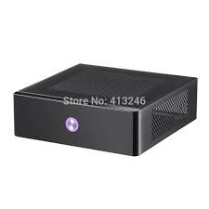

System Unit: is a component in which all processing of data is perform. It is contains central processing unit(CPU), transistors, RAM (main memory), hard drive, mother board, transistors, transformers etc. This components is made up of two types, namely;
Vertical type

Slide 7
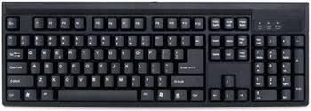
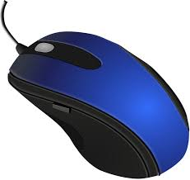
Keyboard: Is a component made up of alphanumeric and symbolic keys that allow the user to input data into the computer. These alphanumeric keys constitute alphabetical keys, functional keys as well as numerical keys. Likewise, Symbolic keys consist of all keys on which only symbols and signs are embossed on.
Mouse: is a component that directs or guide the user to move or select icons on the screen.
keyboard
Mouse

Slide 8
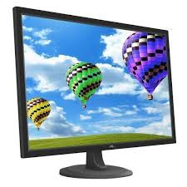
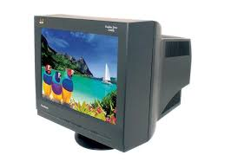
Monitor: is a component of a computer that display information to the user. The monitor consist of two types and it include; . Liquid Crystal Display (LCD) . Cathode Ray Tube
Liquid Crystal Display
Cathode Ray Tube

Slide 9
Types of Computer: n Computers
Personal Computer: The personal computer (PC) defines a computer designed for general use by a single person.

Slide 10
Types of Computer: n Computers
Desktop Computer: Is a personal computer designed for regular use at a single location on or near a desk due to its size and power requirements.

Slide 11
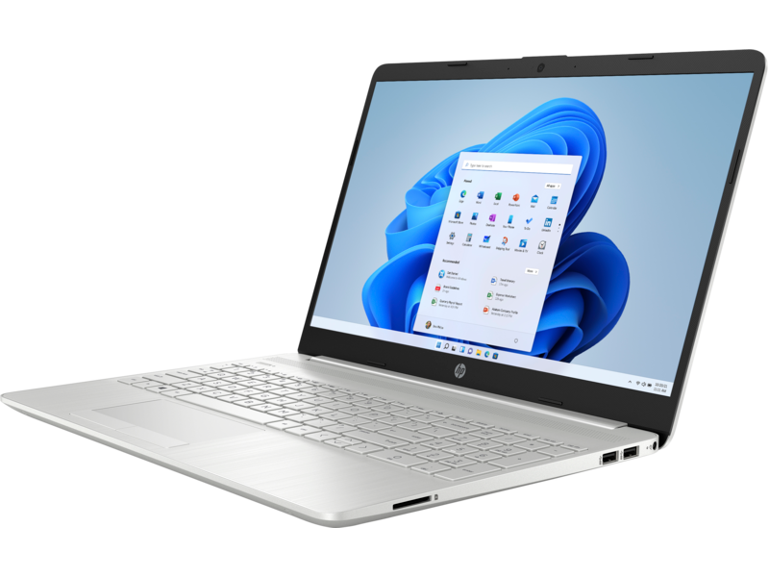
Types of Computer: n Computers
Laptop: Laptops are portable computers that integrate the display, keyboard, a pointing device or trackball, processor, memory and hard drive all in a battery-operated package slightly larger than an average hardcover book.

Slide 12
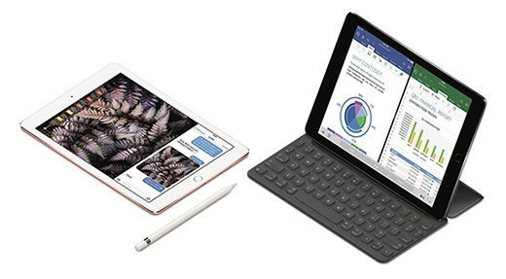
Types of Computer: n Computers
Tablet: is a mobile device, typically with a mobile operating system and touchscreen display processing circuitry, and a rechargeable battery in a single, thin and flat package.

Slide 13
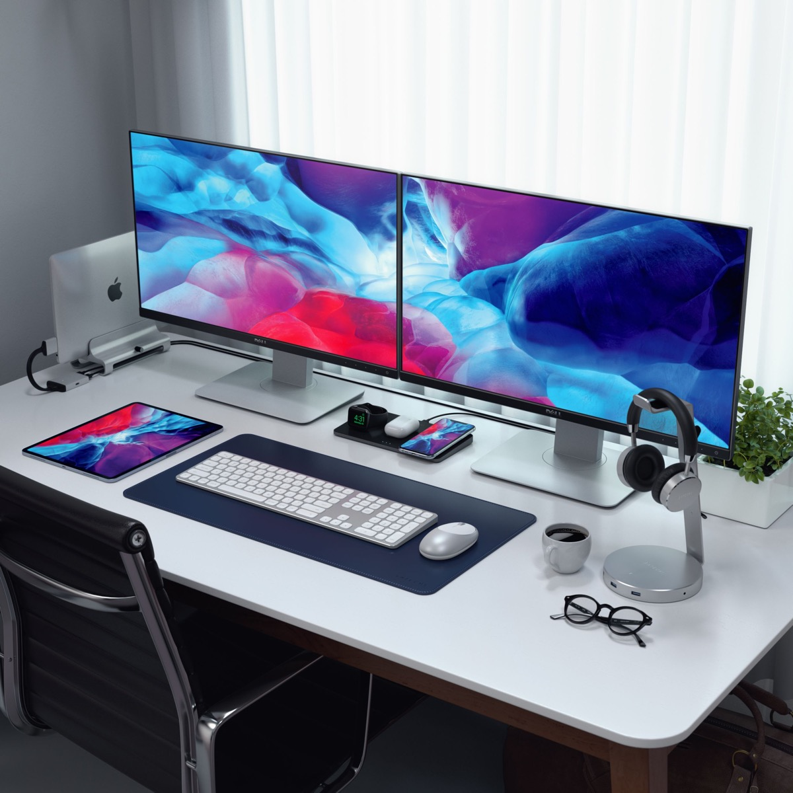
Types of Computer: n Computers
WorkStation: is simply a desktop computer that has a more powerful processor, additional memory, high-end graphics adapters and enhanced capabilities for performing a special group of tasks, such as 3D graphics.

Slide 14
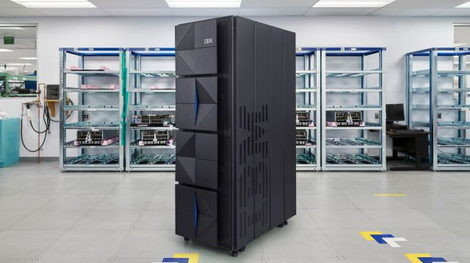
Types of Computer: n Computers
Mainframe Computer: is a computer used primarily by large organizations for critical applications like bulk data processing for tasks such as censuses, industry and consumer statistics, enterprise resource planning, and large-scale transaction processing.

Slide 15
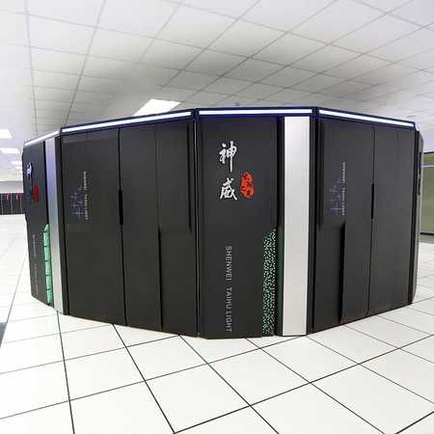
Types of Computer: n Computers
Supercomputer: is a computer with a high level of performance as compared to a general-purpose computer. The performance of a supercomputer is commonly measured in floating-point operations per second instead of million instructions per second.

Slide 16
HARDWARE: they are the physical components of the computer. These devices or components are categorized into input, process, output and storage devices.
Input devices: keyboard, mouse, scanner, Modem, joystick, Digital Cameras, Microphone, Barcode reader etc.
process devices: Central processing unit, RAM, Motherboard, Network card, sound card, video card
Output devices: Monitor, LCD projector, Speakers, Printer, Plotter, headphones webcam etc.
storage devices: Hard drive, Pen drive, Compact disk, DVD, memory card, external hard drive, floppy disk etc.

Slide 17
INFORMATION AND COMMUNICATION TECHNOLOGY (ICT)
Information And Communication Technology (ICT): is defined as the use of computing and communication devices or features to aid communication. It is also the study of developing and using technology to process information and aid communications. This concept is an extension of IT that emphasis the role of unified communication and focuses basically on communication technology.
Therefore, communication technology in modern context include; the internet, wireless network, mobile phone,
It equally improve upon telecommunication services which largely support our daily activities.

Slide 18
INTEGRATED OR EXTERNAL EQUIPMENT
Integrated Equipment: These are devices or parts build in the computer system, with some being detachable and others are not. Most Manufacturers today has made all sensitive parts removal: such as the CPU, CD/DVD Drives, Power supply Unit, Motherboard, hard disk etc.
External Equipment: these are components connected to the outer part of the computer system. These components constitute the peripherals of the computer and as such expands the functionality of the computer. They include; printers, keyboard, Mouse, Scanner, joystick, modem, pen drive etc.

Slide 19
SOFTWARE: is a program (set of instruction) that manages the computer hardware and resources. Examples; WINDOWS 98, Ubuntu, WIDOWS 2000, WINDOWS 7, Mac OS, UNIX, Google Chrome, Fedora, Red hat, WINDOWS XP, Vista, Fire fox, Mavis Beacon etc.
TYPES OF SOFTWARE
System software
Application software

Slide 20
SYSTEM SOFTWARE: is a type of software that allows the computer hardware to become functional. This program is to enable the user to gain access or interact with the computer system and its resources. A good example is the Operating System (OS); such as WINDOWS XP, Vista, Ubuntu, Fedora, WINDOWS 8, WINDOW 10, Mac OS, Red hat, UNIX etc.
APPLICATION SOFTWARE: is a type of software that enable the user to perform a specific task or function. These are basically programs design by potential programmers in their respective endeavor. Examples include; MS office Suite, Web browsers, Mavis Beacon, Players, Games, Coral draw, cartoons, Mobile Apps etc.

Slide 21
SOFTWARE LICENSE: is a document that provides legally binding guidelines for the use and distribution of software. It equally provides the end users the privilege to have one or more copies of the software without violating copyright. The document also contains the terms and conditions mostly include fair-use (legal action against unauthorized permit) of the software. An example of a proprietary product is Adobe Acrobat which allow one to PDF files only with its Acrobat Reader, denying one the privileges unless it is subscribe by the user. Perhaps, there are some free Linux operating system versions that use and redistributed to others.
It is also peculiar to the End User License Agreement (EULA); which is a legal contract between the software publisher and end user.
But it is imperative that software license in our modern context is either proprietary, free or open source. The distinguish features being the terms under which end users may redistribute or copy the software for future development.

Slide 22
THANK YOU

